Slide 1


SQL Part 2

Slide 2
SQL (Structured Query Language) is a programming language used to manage and manipulate relational databases.
It allows users to perform various operations on data, such as retrieving, inserting, updating, and deleting records.
SQL is the standard language for working with relational database management systems (RDBMS) like MySQL, PostgreSQL, Microsoft SQL Server, Oracle, and SQLite.

Slide 3
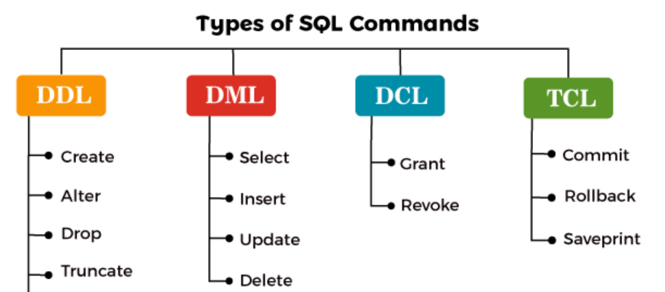

Slide 4




Slide 5
Constraints in databases are rules or conditions that must be met for data to be
inserted, updated, or deleted in a database table. They are used to enforce the
integrity of the data stored in a database and to prevent data from becoming
inconsistent or corrupted.
1. NOT NULL
2. UNIQUE(combo)
-> Another way of creating constraint
3. PRIMARY KEY
4. AUTO INCREMENT
5. CHECK
6. DEFAULT
7. FOREIGN KEY

Slide 6
DML
INSERT
INSERT query
INSERT query variation
INSERT multiple values
Import data into MySQL Workbench
Retreive

Slide 7

Thank you

